Slide 1

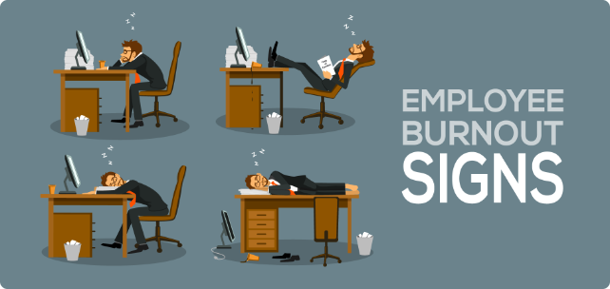

Employee Burnout Prediction
This presentation will introduce an AI-driven project to predict and prevent employee burnout. By leveraging deep learning techniques, we aim to provide organizations with valuable insights to support their workforce and promote well-being.
Nukala Sai Charan
AP22110010091
SRM University AP

Slide 2
Edunet
Edunet Foundation is a dynamic organization that creates educational networks to promote employability and entrepreneurship. With Special Consultative Status from the UN Economic and Social Council (ECOSOC) since 2020, EF's national programs - both online and instructor-led - reach and empower tens of thousands of learners every year.
Key Specialties
Skill Development
E-Learning
Innovation
Micro-entrepreneurship
Classroom Learning
Experiential Education
Future Skills
New Collar Careers
Employability
Industry Focus
Education Administration Programs

Slide 3
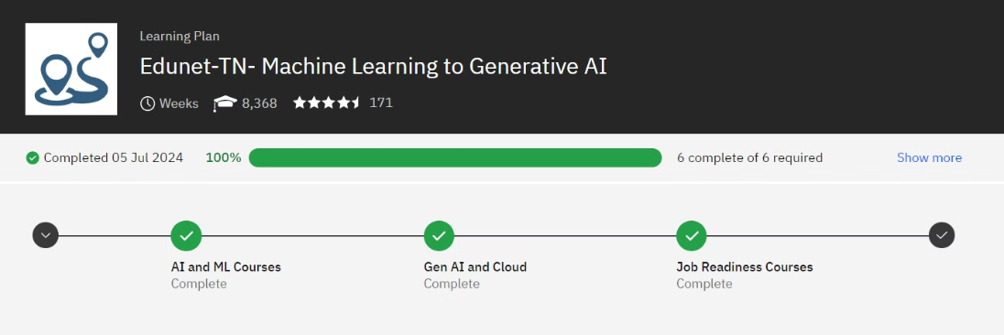
Summer Internship Progress Report
Over the course of this internship, I've made steady progress on the key objectives:
Completed the personalized learning plan provided by Edunet, equipping me with essential new skills.
Successfully set up my Jupyter Notebook environment and imported the necessary dataset to power the project.
Currently hard at work on the final project deliverables, pushing to complete it to a high standard.

Slide 4


Introduction to Employee Burnout
1
Defining Burnout
Burnout is a state of physical, emotional, and mental exhaustion caused by prolonged stress and excessive workload.
2
Negative Impacts
Burnout can lead to decreased productivity, increased absenteeism, and poor employee engagement, ultimately impacting the overall organizational performance.
3
Importance of Prediction
Proactively identifying and addressing burnout can help organizations retain talented employees and create a healthier, more sustainable work environment.

Slide 5
Deep Learning for Burnout Prediction
Data Collection
Model Development
Actionable Insights
We will gather a diverse dataset of employee data, including demographic information, work patterns, and self-reported stress levels.
Using deep learning algorithms, we will train a predictive model to identify patterns and early indicators of burnout among employees.
The model will provide organizations with valuable insights to implement targeted interventions and support programs for at-risk employees.

Slide 6


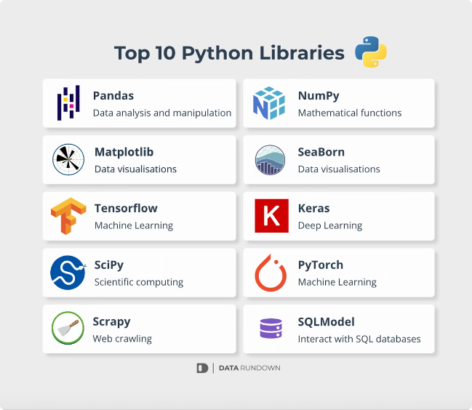


Key Python Libraries
Pandas
For data manipulation and analysis
Scikit-learn
Comprehensive machine learning library for model development
Matplotlib & Seaborn
For creating insightful data visualizations

Slide 7
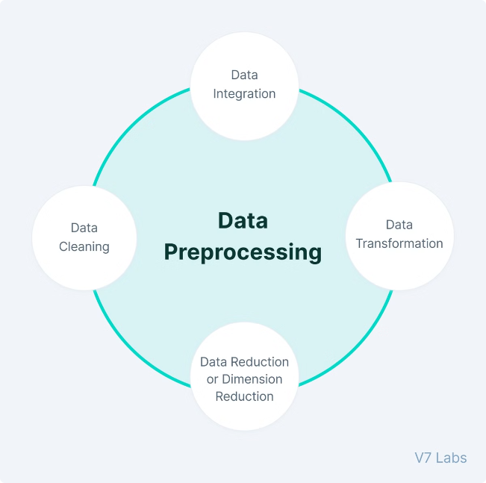



Data Collection and Preprocessing
Data Sources
Gather employee data from various sources, such as HR records, performance reviews, and self-reported surveys.
Data Cleaning
Clean and preprocess the data to address missing values, outliers, and inconsistencies.
Feature Engineering
Create new features and transform existing data to enhance the predictive power of the deep learning model.

Slide 8
Employee Burnout Prediction Using Linear Regression
To predict employee burnout, we will leverage the power of linear regression, a widely-used machine learning technique. This model will help identify the key factors contributing to burnout, enabling organizations to proactively address these issues and support their workforce.
Identify Predictive Factors: The model will analyze employee data, such as workload, stress levels, and job satisfaction, to determine the most significant predictors of burnout.
Measure Burnout Risk: Based on the identified factors, the linear regression model will provide a quantitative assessment of an employee's burnout risk, allowing for targeted intervention.
Personalized Recommendations: The model's insights will inform tailored strategies to mitigate burnout, such as adjusting workloads, enhancing support systems, or providing mental health resources.

Slide 9

Test Cases & Expected Output
Let's review two example test cases and their expected outputs:
Test Case 1: Inputs: Workload - Low (30 hours/week), Mental Fatigue - Low (2/10), Job Designation - Team Lead, Work-Life Balance - Moderate (occasional remote work) Output: Burnout Risk - Low (predicted score 0.15)
Test Case 2: Inputs: Workload - High (55 hours/week), Mental Fatigue - High (8/10), Job Designation - Project Manager, Work-Life Balance - Poor (frequent travel) Output: Burnout Risk - High (predicted score 0.75)

